Slide 1
TUN Competition: Hire Heroes USA
INFO 320 - Group 8
Ranierl Agarin, Daniel Ha, Jonathan Peck, Austin Bui

Slide 2

Business Information
Hire Heroes USA
Non-profit
Aiding military veterans find employment

Slide 3

Business Question
Is there a relationship between certain days of the week, times in the day, or months, or time of year and when employers and job seekers create accounts?
Why it matters? →
Tax cuts
Optimize max number of veterans helped
Save employers money (job listings)
Boosts economy. Non-profit
Notes:
***Look at time of day, what day of week, and what month accts are made
*matters bc →
Tax cuts for employers for hiring veterans = good for employers to optimize postings
Save them money for listings (HH charges rates for listings)
Hiring people = boosting economy. Non profit so any outcome is good
Optimize resources to maximize number of veterans helped = maximize commission

Slide 4

Methodology
Provided Excel Files
Software
Assumptions
Cleaning
Modeling
Notes:
Files: Job Seeker Profile Creation and Employer Profile Creation
Software: Excel files for cleaning. Tableau desktop for modeling
Assumptions: (job seeker branch and skill level does not matter, employers are posting jobs consistently and not as PR, how employer heard of HH does not matter, sfhjdshfjsg)
Cleaning: ignored city, used state and UTC time to create time zones, converted back into local time)
Modeling: imported files into tableau desktop, records and times

Slide 5
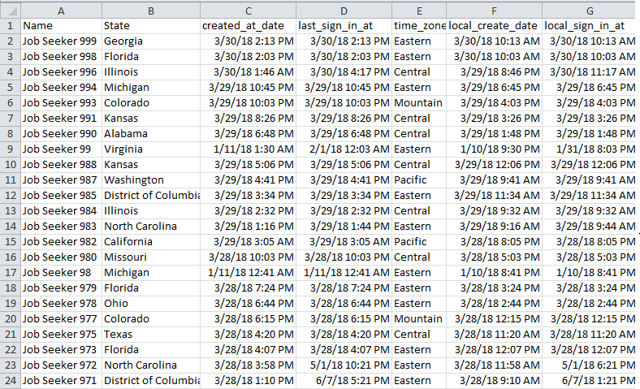
Methodology
Notes:
Files: Job Seeker Profile Creation and Employer Profile Creation
Software: Excel files for cleaning. Tableau desktop for modeling
Assumptions: (job seeker branch and skill level does not matter, employers are posting jobs consistently and not as PR, how employer heard of HH does not matter, sfhjdshfjsg)
Cleaning: ignored city, used state and UTC time to create time zones, converted back into local time)
Modeling: imported files into tableau desktop, records and times

Slide 6
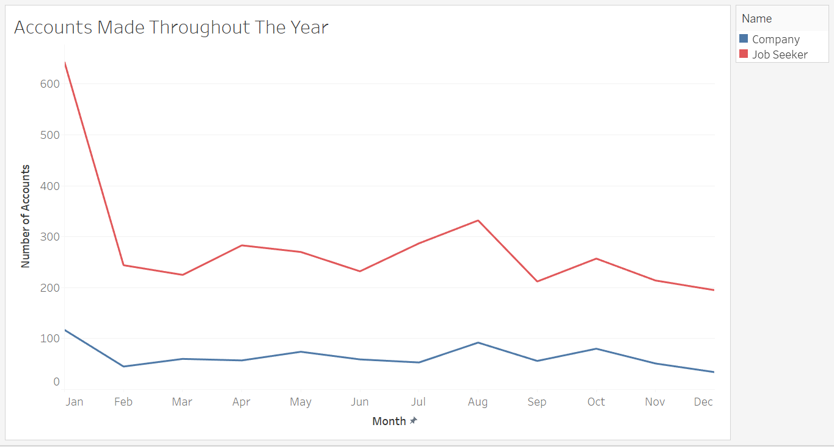
Findings
Correlations
Month? Day? Time?
Appendix 1
Notes:
Job seekers and employers all follow roughly the same pattern regardless of time zone

Slide 7
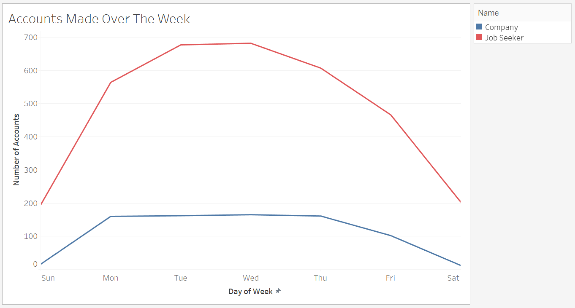
Appendix 2

Slide 8
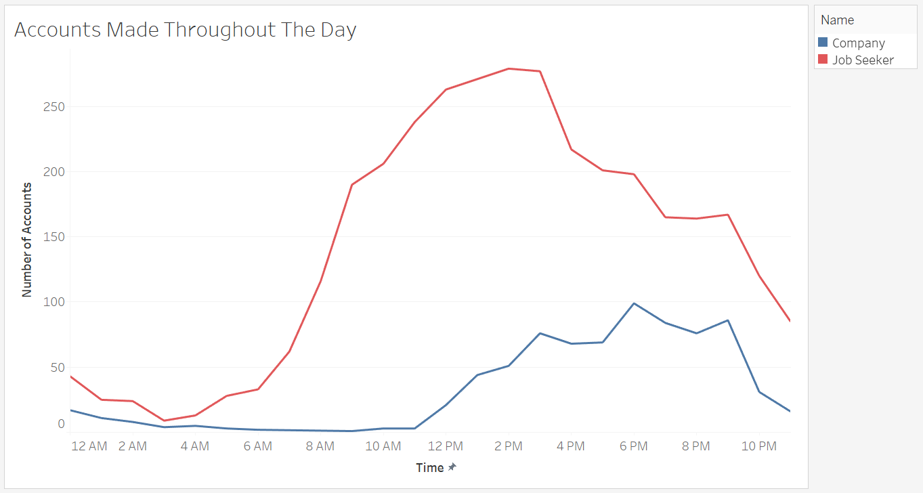
Appendix 3

Slide 9

Proposed Solution
Adjust advertising for job seekers, Commission
Increase incentives for businesses
Peak and lull periods

